Slide 1
Environmental conflict tracker
John Brandt

Slide 2
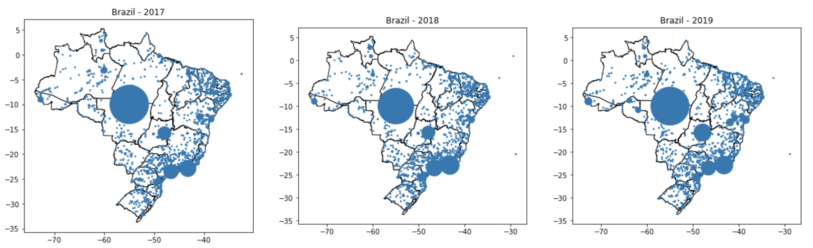
Brazil
890,000 articles

Slide 3
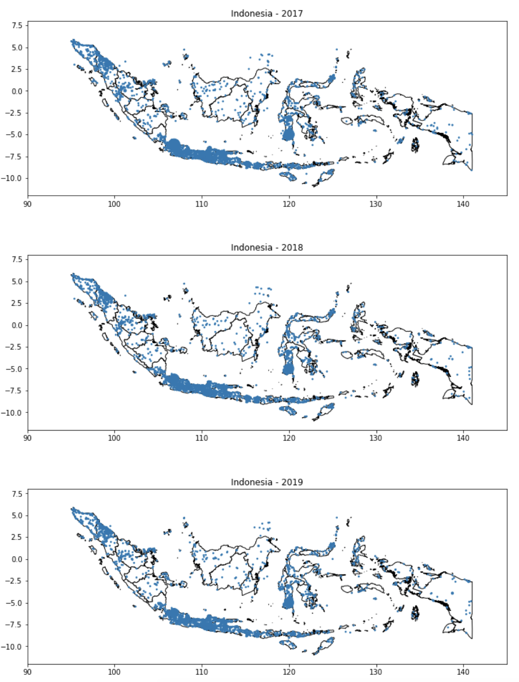
Indonesia
1.2 million articles

Slide 4
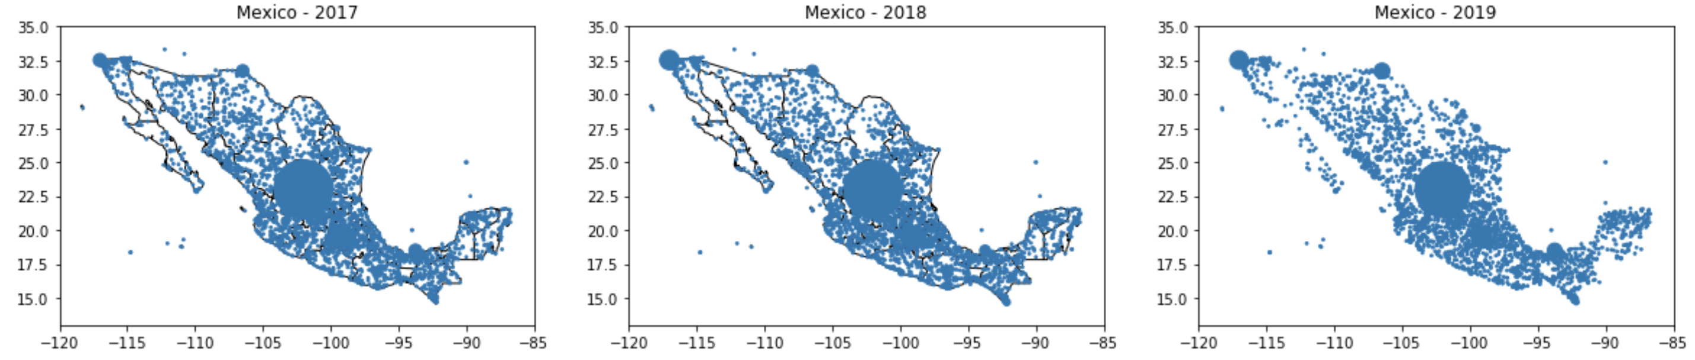
Mexico
1.4 million articles

Slide 5
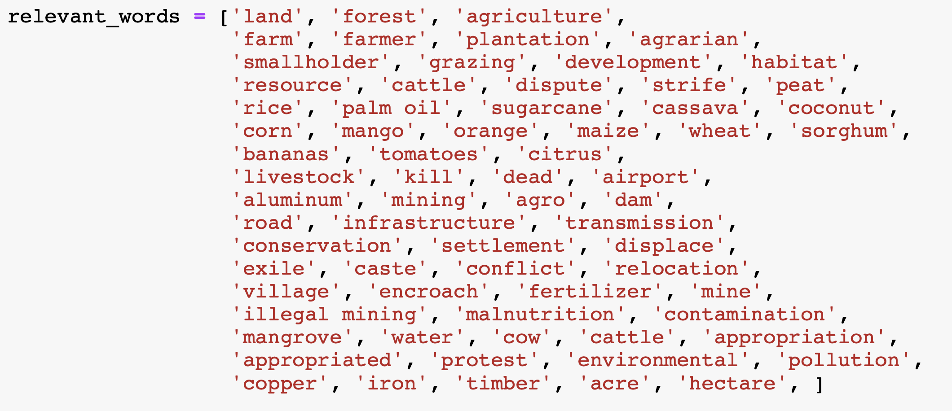
Generating candidate articles

Slide 6
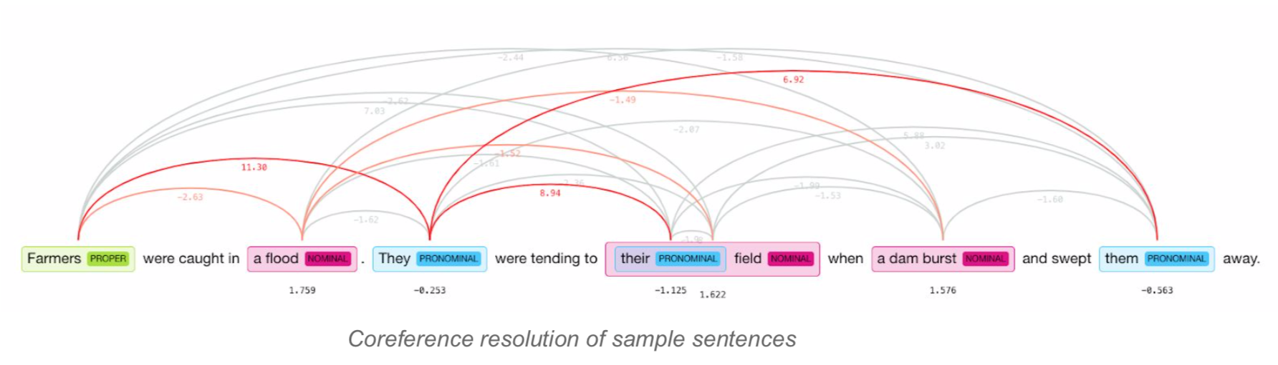

Slide 7
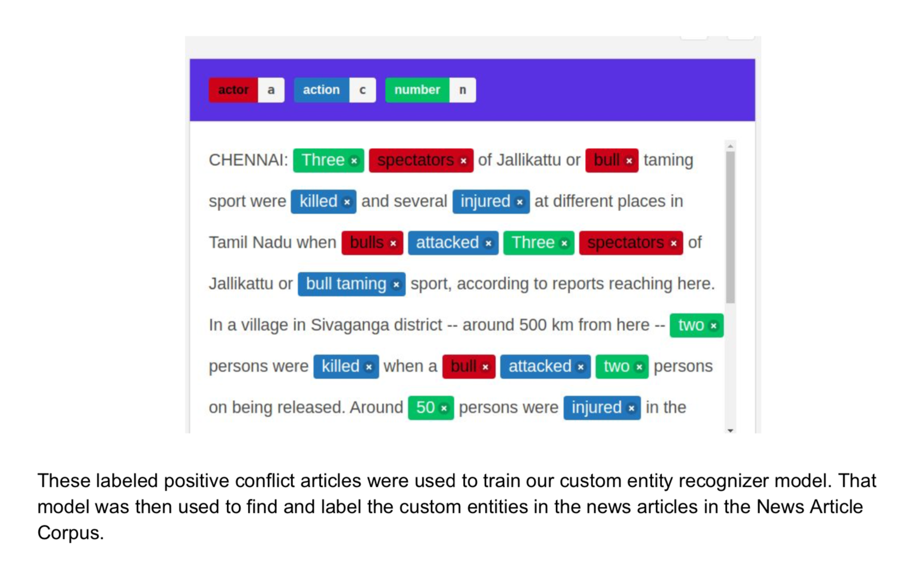

Slide 8
